Slide 1
Restaurant Management System
Nischal Pandey
Samrakshyan Lamichhane

Slide 2
Introduction
Streamlining Operations: RMS aims to streamline and automate various processes within a restaurant, from order placement to inventory management and staff coordination.
Enhancing Efficiency: By utilizing advanced technology, RMS improves the overall efficiency of restaurant operations, reducing manual errors and optimizing workflows.
Customer Experience: The system is designed to enhance the customer experience by ensuring accurate and timely order processing, personalized services, and improved communication.
Inventory Optimization: RMS assists in effective inventory management, helping restaurants to keep track of stock levels, minimize wastage, and ensure timely restocking of items.
Real-time Insights: The system provides real-time insights into sales, customer preferences, and inventory status, enabling informed decision-making for restaurant managers and owners.
Adaptability: RMS is adaptable to different types and sizes of restaurants, offering scalability to accommodate the unique needs and challenges of each establishment.

Slide 3
Objective
Enhance order processing efficiency to reduce wait times and increase customer satisfaction.
Improve inventory management accuracy and streamline the restocking process.
Provide a user-friendly interface for both customers and restaurant staff to ensure a seamless experience.
Implement a robust reporting system to enable data-driven decision-making for the management team.
Enhance the overall dining experience by integrating features such as online ordering, table reservations, and feedback collection.

Slide 4
Scope of the project
Order Processing: Implement a comprehensive order processing system to efficiently handle customer orders, including order placement, modification, and cancellation.
Inventory Management: Develop a robust inventory management module to monitor stock levels, track ingredient usage, and automate reordering processes.
Menu Customization: Allow for easy customization of menus, enabling the addition, removal, or modification of dishes based on seasonal changes or new offerings.

Slide 5
SDLC model
Planning: Determine the project scope, objectives, requirements, and constraints for the Restaurant Management System. Identify the essential functionalities needed to streamline restaurant operations, setting the stage for subsequent phases.
Analysis: Gather and analyze specific requirements for the Restaurant Management System. Understand user needs, data flow, and system architecture to lay a solid foundation for the subsequent design phase.
Design: Create a detailed design of the system architecture, database schema, and user interface for the Restaurant Management System. Develop algorithms, use case diagrams, flowcharts, and context diagrams, along with defining necessary data structures for efficient management.
Implementation: Write the code for the Restaurant Management System using the Java programming language. This involves creating classes, methods, and interfaces according to the design specifications.
Testing: Perform unit testing to ensure each component of the system functions correctly. Conduct integration testing to verify interactions between different modules. Also, carry out system testing to validate the entire Restaurant Management System.

Slide 6
Contd…
Deployment: Deploy the Restaurant Management System in a real-world environment. This may involve installation, configuration, and setup on servers or client machines, ensuring a smooth transition from development to live operation.
Maintenance: Provide ongoing support and maintenance for the Restaurant Management System. This includes addressing bug fixes, implementing updates, and making enhancements based on user feedback and evolving requirements

Slide 7
Feasibility analysis
Economic Feasibility: Cost-Benefit Analysis demonstrated a favorable return on investment. Detailed breakdown of development, maintenance, and operational costs.
Technical Feasibility: Compatibility with existing hardware and software systems assessed. Availability of required technology and expertise evaluated.
Operational Feasibility: Impact on current restaurant operations considered. User acceptance and training programs planned.
Scheduling Feasibility: Development timeline outlined with key milestones. Dependencies and potential risks identified and mitigated.

Slide 8
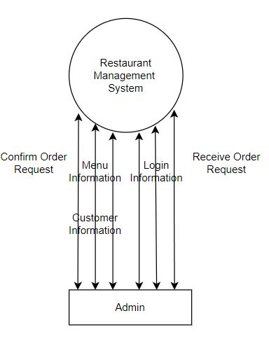
Context diagram

Slide 9
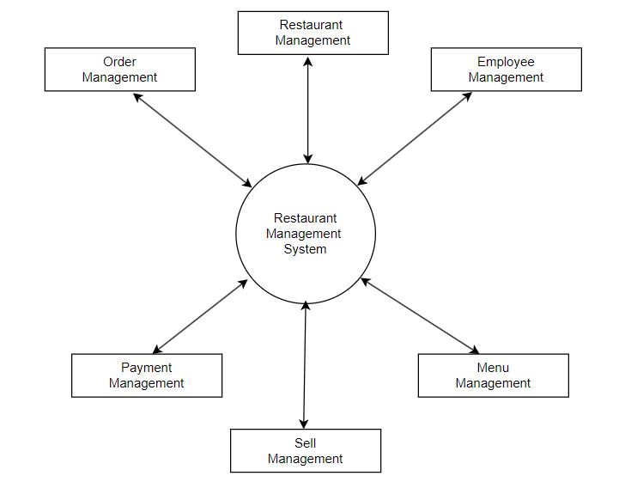
Data Flow diagram

Slide 10
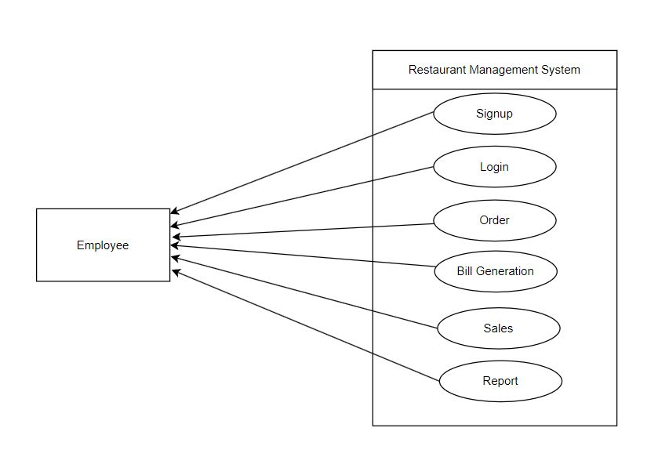
Use case diagrams

Slide 11
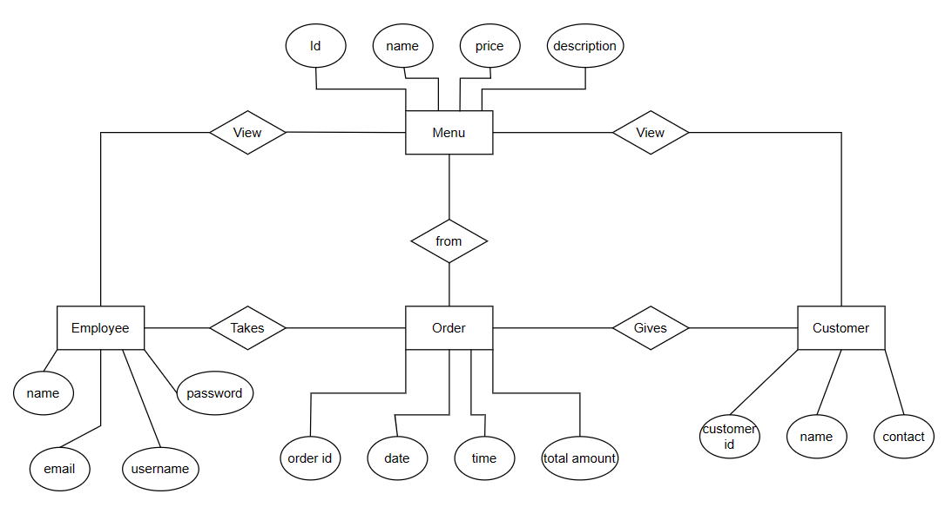
Er-diagram

Slide 12
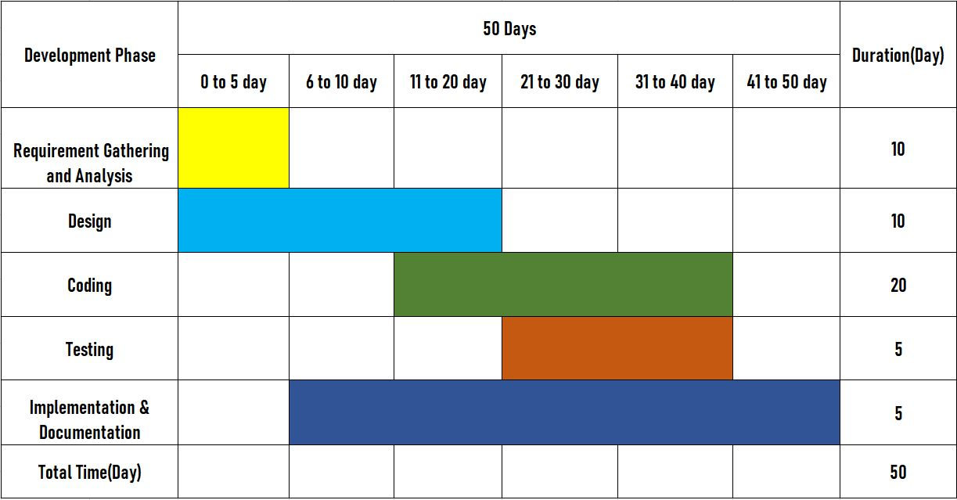
Gantt chart

Slide 13
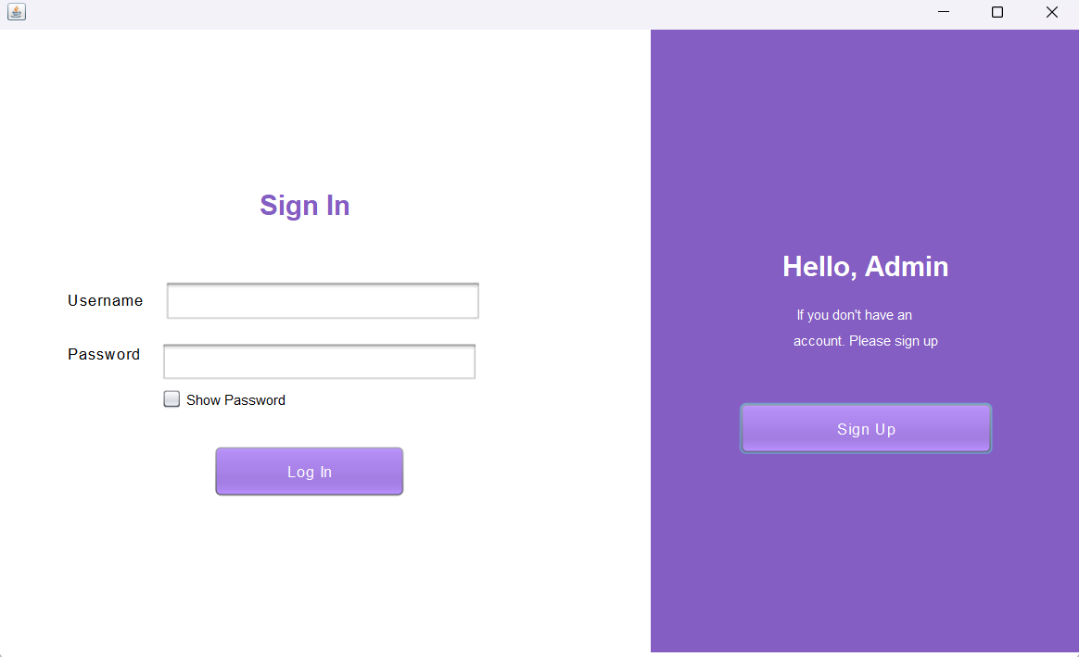
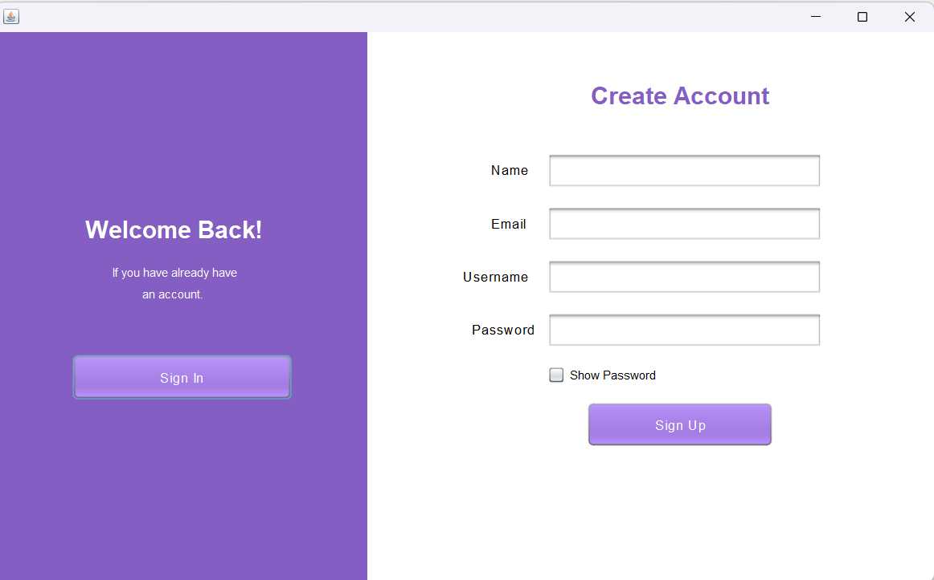
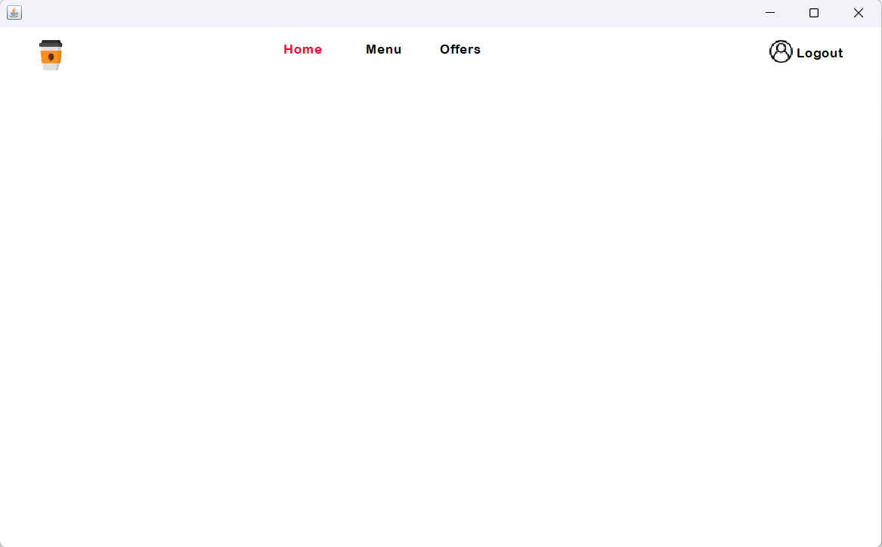
Expected Outcome

Slide 14
Conclusion
In conclusion, the development of our Restaurant Management System represents not just a technological upgrade but a transformative step in the way restaurants operate. By addressing key challenges in order processing, inventory management, and customer service, our RMS is poised to elevate the overall efficiency and effectiveness of restaurant operations. The careful consideration of feasibility, the selection of an appropriate SDLC model, and the comprehensive design of our system contribute to our confidence in the success of this project. As we move forward, we anticipate a positive impact on both the customer experience and the operational efficiency of restaurants. We appreciate your attention throughout this presentation and are now open to any questions or feedback you may have.

Slide 15
reference
Gupta, R., & Singh, A. (2022). "Restaurant Management System: Design and Implementation."
Oracle Corporation. (2022). "MySQL Documentation." https://dev.mysql.com/doc/
Spring Framework. (2022). "Spring Framework Documentation." https://docs.spring.io/spring-framework/docs/current/reference/html/
Java Documentation. (2022). https://docs.oracle.com/en/java/
MySQL. (2022). "MySQL 8.0 Reference Manual." https://dev.mysql.com/doc/refman/8.0/en/

Slide 16

Thank you
Nischal Pandey
Samrakshyan Lamichhane

